Slide 1
Lambda Function in Python
Anonymous Presenters

Slide 2
Introduction of Lambda
PART I

Slide 3
Lambda Function in Python
Lambda functions provide a concise way to create:
small, anonymous functions [1]
without needing to define a formal function using def.
[1] A. Burgaud, "How to Use Python Lambda Functions," Real Python, Jun. 19, 2019. [Online]. Available: https://realpython.com/python-lambda/

Slide 4
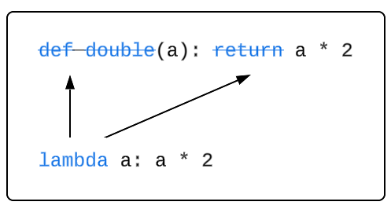
Syntax of Lambda Function in Python
the expression of lambda function is composed of:
The keyword: lambda
A bound variable: x
A body

Slide 5
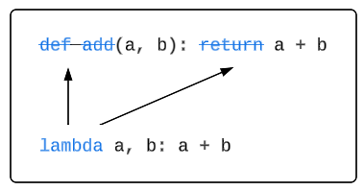
Differences between lambda and def functions
Syntax:

Slide 6
Differences between lambda and def functions [2]
Return:
Lambda functions implicitly return the result of evaluating the expression
def functions use an explicit return statement.
Scope:
Lambda functions are limited to a single expression.
Def functions can contain multiple statements and have more complex logic.
[2] "Python Lambda Functions," GeeksforGeeks, Jun. 20, 2024. [Online]. Available: https://www.geeksforgeeks.org/python-lambda-anonymous-functions-filter-map-reduce/

Slide 7
Lambda Function in Python
handy
anonymous
needed for a short period

Slide 8
Example of usage: Gradebook [3]
PART II
[3] Northeastern CS 5001, "Homework 5, Gradebook," [Online]. Available: https://northeastern.instructure.com/courses/192162/assignments/2364714?module_item_id=10749754

Slide 9
Thank you!

